Slide 1

“FOOD ORDERING SYSTEM”
Task - 4

Slide 2

FOOD ORDERING SYSTEM
It allows user to browse menus, select dishes, place order and pay for food from restaurant this system stream line the process, providing convenience to customers to make efficient order management for restaurants.
▪
LMS Username
Name
Batch
au421320104006
BARANI S
1
au421320104013
JEEVITHA G
1
au421320104015
KEERTHIGA M
1
au421320104022
NITHYA K
1

Slide 3
Integrate the API to the frontend to ensure dynamic feature: 1.Choose a database System 2.Set Up the database 3.Backend Integrations 4.Connect Backend to the Database 5.Test and debug 6.Implement Security Measures 7.Optimize and scale 8.Document and Maintain

Slide 4
Learning Outcome: • Connecting a database in a Food Ordering Website is a comprehensive set of learning outcomes. Individuals develop crucial skills in database management by grasping the fundamentals of setting up and managing databases such as MySQL Proficiency in Structured Query Language (SQL) is acquired, empowering the execution of critical operations like inserting, updating, querying, and deleting data. • Learners gain an understanding of data modeling and design, allowing the creation of efficient and normalized database structures tailored for ordering management. • Connecting backend applications to databases becomes second nature, enabling the implementation of essential Create, Read, Update, and Delete (CRUD) functionalities. • Emphasis on data security measures, error handling, and optimization techniques fortifies skills in maintaining the integrity, security, and performance of the database. • Validating and sanitizing user inputs to practical application through hands-on projects, this learning journey equips individuals with practical and theoretical knowledge for proficiently managing and manipulating ordering data within a database system.

Slide 5
Step-Wise Description
Step 1: Choose a Database Management System (DBMS)
Select a DBMS: Choose a suitable database system such as MySQL, based on the project's requirements and
scalability needs.
Step 2: Set Up the Database
Install and Configure: Install the MySQL and configure it on your server or local machine.
Create the Database: Using the DBMS tools or command-line interface, create a database specifically for
managing data.
Step 3: Define Database Schema
Design Database Schema: Plan and design the structure of the database, including for products, orders, users, etc.
Step 4: Backend Integration
Choose Backend Technology: Select a backend technology or framework Node.js for your application.
Install Database Drivers: Install necessary database drivers or ORM libraries to connect your chosen
backend technology to the database.

Slide 6
Step 5: Connect the Backend to the Database Configure Database Connection: Set up a connection to the database within your backend code, providing the necessary connection details such as host, port, username, password, and database name. Create CRUD Operations: Write code to perform CRUD operations (Create, Read, Update, and Delete) within your backend code, allowing your application to interact with the database. Step 6: Test and Debug Test Database Connectivity: Ensure that your backend application can connect to the database and perform CRUD operations accurately. Handle Errors: Implement error handling mechanisms for database-related errors, ensuring robustness and data integrity. Step 7: Implement Security Measures Secure Data Inputs: Implement data validation and parameterized queries to prevent SQL injection attacks and maintain data security.

Slide 7
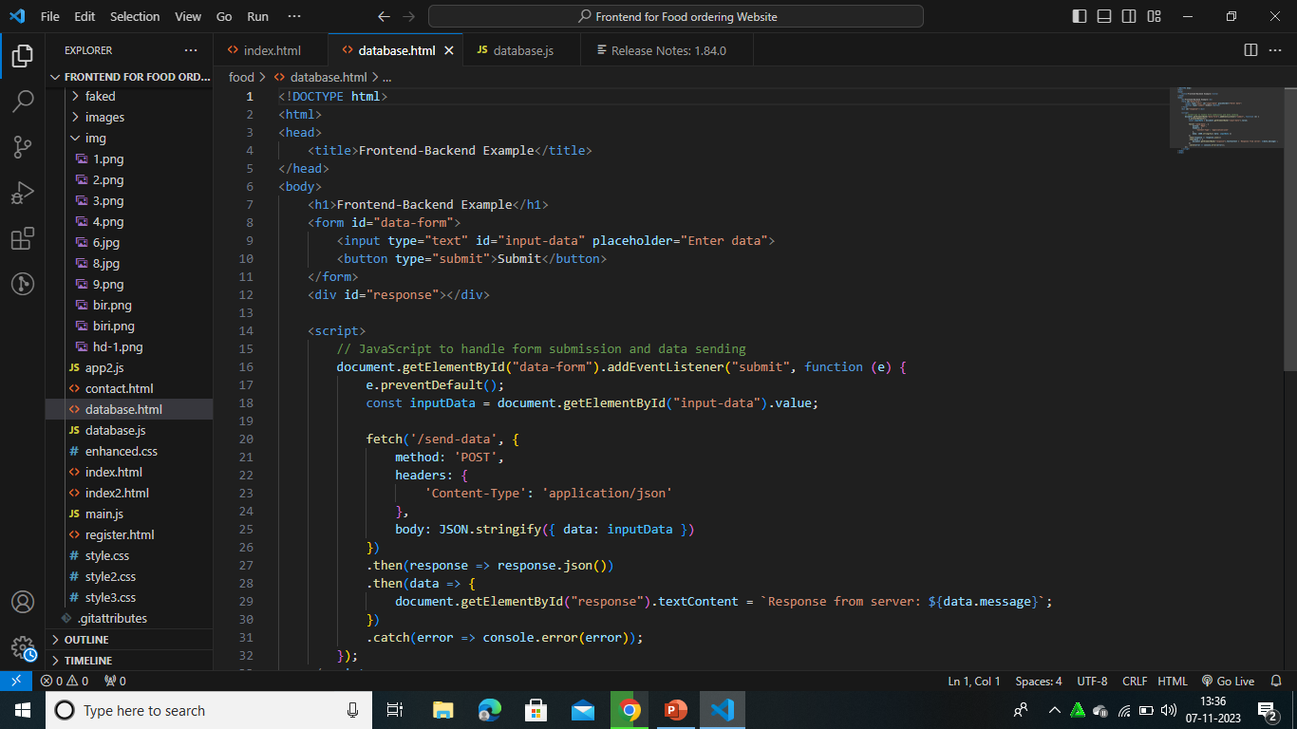

Slide 8
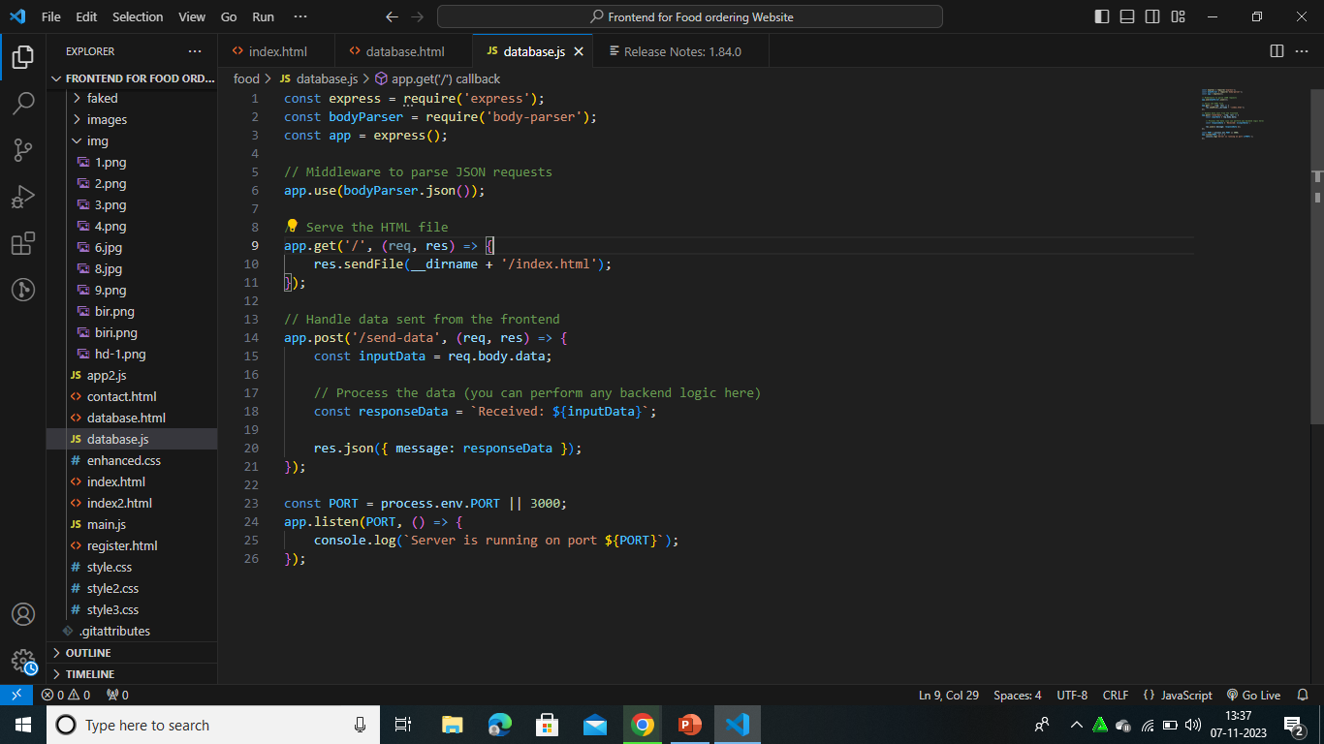

Slide 9
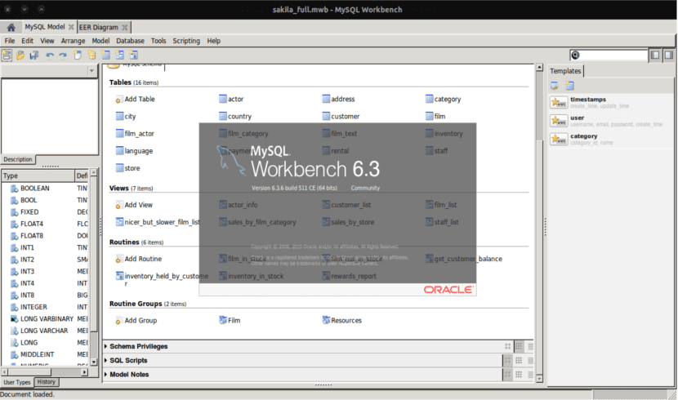

Slide 10
Summary of your task
A food ordering system is a digital platform that simplifies the process of ordering food from various restaurant it allow user to explore menus , select dished, customize order and securely place them for delivery or pick up.
Overall, this system revolutionizes the way people access and enjoy food, offering convenience and accessibility in the dining experience.

Slide 11

Submission Github
Insert Your Github Link Here

Slide 12


